Slide 1

Discovering China
German Companies in China - Trends, Experiences, Testimonials

Slide 2
Content:
Part 1: German Enterprises in China: Figures and dimension
Part 2: Expansion of capital export - the steps into China - and the needs for recruiting and training
Part 3:Memories!
Part 4: The future? Discussion

Slide 3
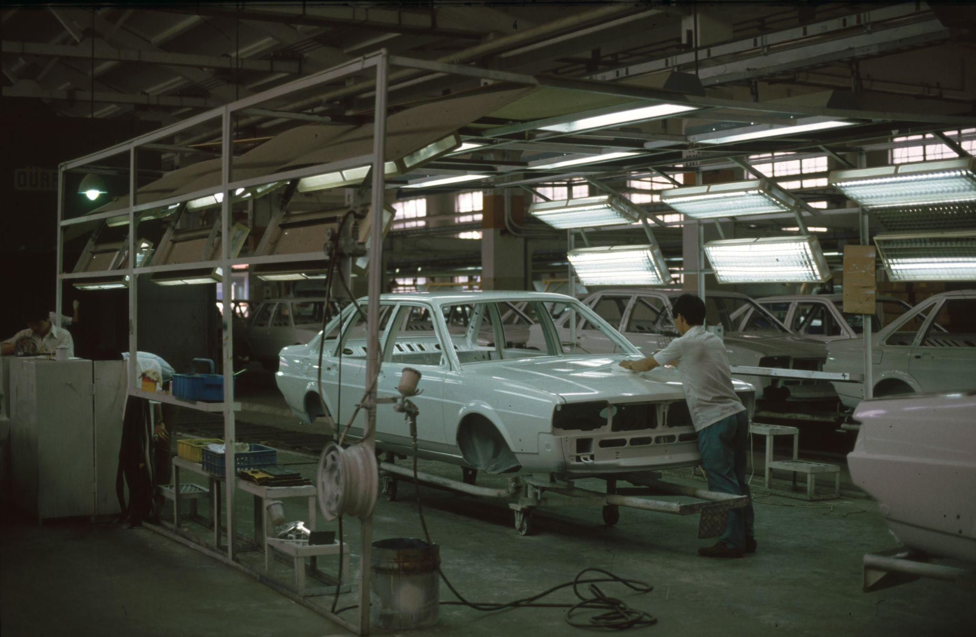

Slide 4
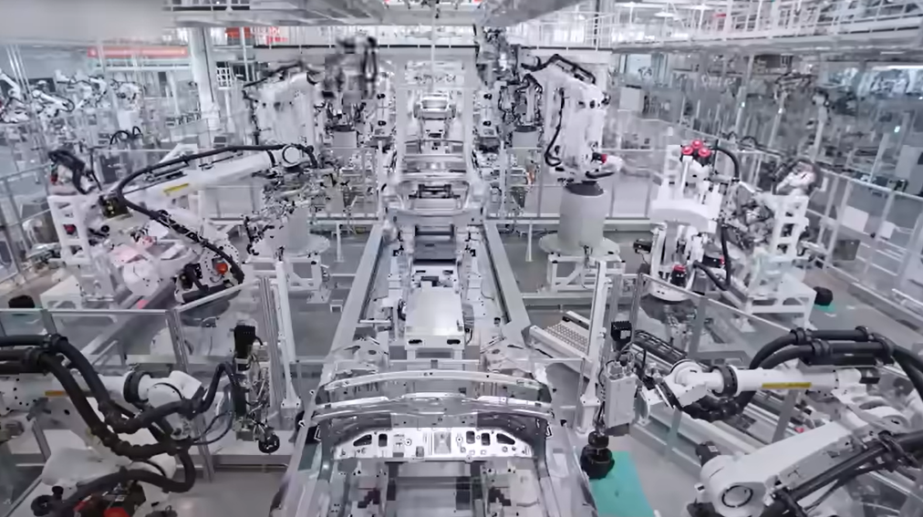

Slide 5
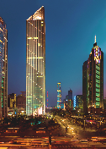
German Enterprises in China
Regions
5.200
Yangtze Delta 51.7%
Bohai economic area 18.3%
Pearl River Delta 12.9%
Periphery Yangtze, Per River, Bohai 6.4%
Northeast 3.7%
West 1.8%
Other regions 5.2%
The company
Heilongjiang
Shenyang
Jilin
97billion €
Xinjiang
Liaoning
Inner Mongolia
Beijing
Investments
Tianjin
"only"
5.5 billion €
CHN in DE
Hebei
Ningxia
Shanxi
Shandong
Sectors
Qinghai
Jiangsu
Gansu
Shaanxi
Henan
1.1 million
Jobs
Anhui
Shanghai
Mechanical engineering
Automobile
Services
Chemistry
Electronics
Plastic/metal
Tibet
Hubei
Sichuan
Distribution of companies
Chongqing
Zhejiang
Hunan
Jiangxi
Guizhou
Fujian
Guangxi
Guangzhou
Yunnan
Guangdong
Hainan

Slide 6
Part 2: The Germans in China: Expansion of Capital
Phase 1: Understanding market potential, the courage to be present
Phase 2: Export of goods, sales partnerships, relationship networks
Phase 3: Corporate presence in joint ventures and own national subsidiaries
Phase 4: Setting up own production sites, developing local supply chains
Phase 5: China's knowledge-based economy as a challenge
now:
Phase 6: Stand firm - against all stormy winds

Slide 7
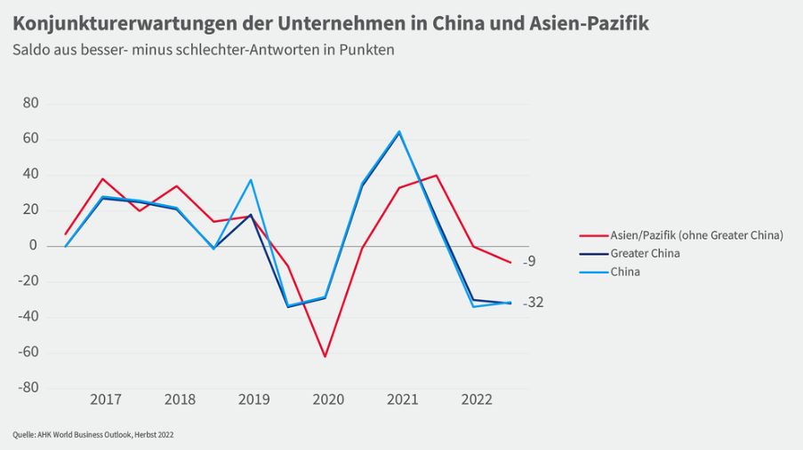
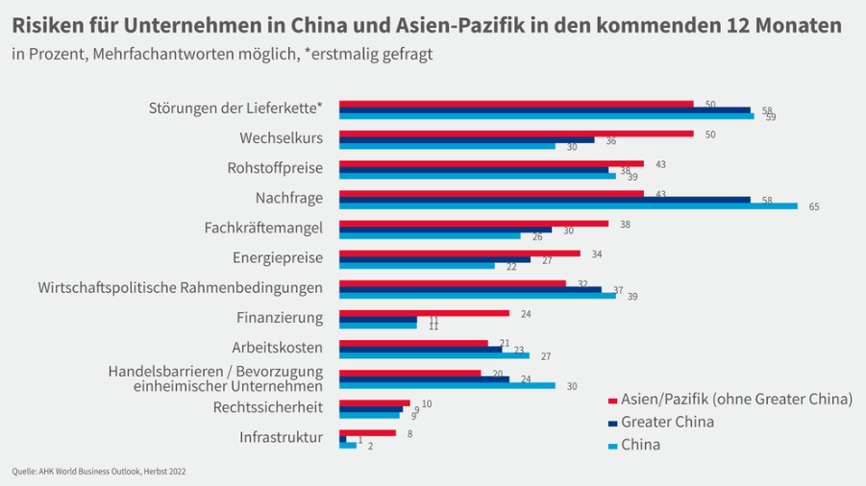
EUR 900 billion
Is China investing in the "New Silk Road"?
2
EUR 3 billion
Investments in
Artificial intelligence
until 2025
EUR 145 billion investment in artificial intelligence by 2030
14 Bill. EUR
Cashless payments 2017
EUR 21 million
Cashless payments
2017
Notes:
Did you know that China wants to invest 145 billion euros in artificial intelligence development by 2030; the German government announced on November 18 that we only want to invest 3 billion euros in artificial intelligence by 2025?
Did you know that 10,000 new start-ups are born every day in China? According to estimates, there are a total of 7,000 in Germany.
Did you know that 125,000 km of track have been laid in China since 1953; in Germany the figure is just under 35,000 km since 1835. By 2030, China plans to lay 38,000 km of high-speed rail alone, 25,000 km of which have already been laid since 2008. Incidentally, the last completely newly built line in Germany was opened in December 2017: 107 km from Erfurt to Nuremberg. Construction began in 1996.
(pop up 70% graphic)
Did you know that China plans to be 70% economically independent in major industries such as mechanical engineering by 2025 as part of its major industrial policy? Surely also at the expense of the local German economy?
Age of railroad infrastructure in Germany 54.7 years - New bridges
Technical condition 2017: 2751 interlockings, electronic: 390. interlocking walls Innovations cable hoists 150 years
33488. 60%

Slide 8
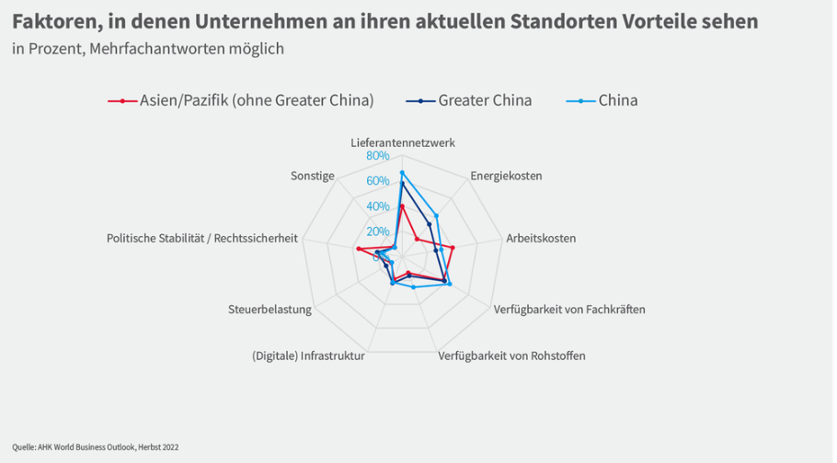
EUR 900 billion
Is China investing in the "New Silk Road"?
3
EUR 3 billion
Investments in
Artificial intelligence
until 2025
EUR 145 billion investment in artificial intelligence by 2030
14 Bill. EUR
Cashless payments 2017
EUR 21 million
Cashless payments
2017
Notes:
Did you know that China wants to invest 145 billion euros in artificial intelligence development by 2030; the German government announced on November 18 that we only want to invest 3 billion euros in artificial intelligence by 2025?
Did you know that 10,000 new start-ups are born every day in China? According to estimates, there are a total of 7,000 in Germany.
Did you know that 125,000 km of track have been laid in China since 1953; in Germany it has been just under 35,000 km since 1835. China plans to lay 38,000 km of high-speed rail alone by 2030, 25,000 km of which have already been laid since 2008. Incidentally, the last completely newly built line in Germany was opened in December 2017: 107 km from Erfurt to Nuremberg. Construction began in 1996.
(pop up 70% graphic)
Did you know that China plans to be 70% economically independent in major industries such as mechanical engineering by 2025 as part of its major industrial policy? Surely also at the expense of the local German economy?
Age of railroad infrastructure in Germany 54.7 years - New bridges
Technical condition 2017: 2751 interlockings, electronic: 390. interlocking walls Innovations cable hoists 150 years
33488. 60%

Slide 9
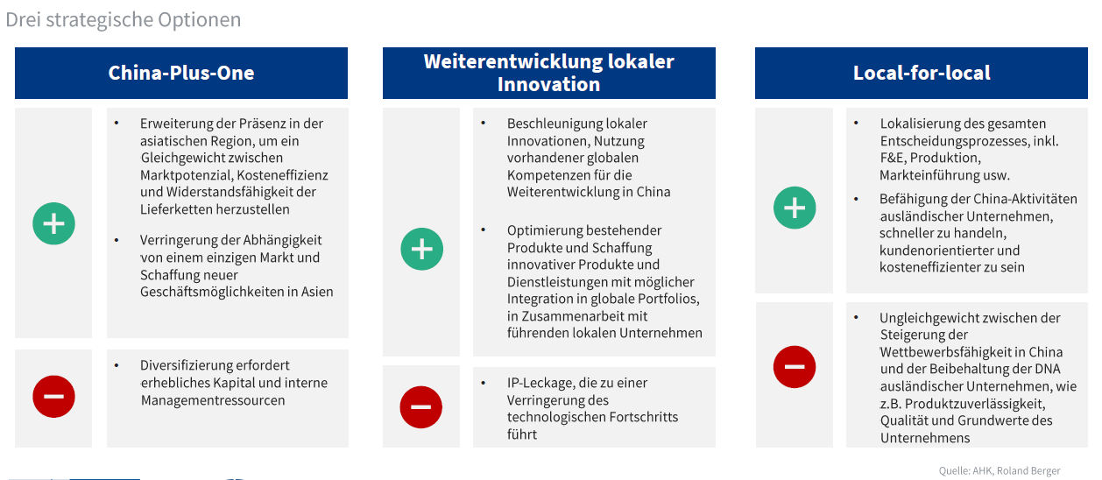
China strategy(ies)
Significance for the companies
Comprehensive reporting obligations for companies on their existing relationship with China (in addition to LkSG reporting obligations)
Companies "particularly exposed to China" may be required to
Summarize figures relevant to China
Subject to a separate notification obligation
Undergo regular self-imposed or mandatory stress tests in order to identify China-specific risks at an early stage and take corrective action.
(Reference scenario: complete discontinuation of business in China)
14 Bill. EUR
Cashless payments 2017

Slide 10
Part 3: Some Memories and a testimonial
Personal memories of entrepreneurs & publications on China
Speaking with Dr. Thomas Kiefer

Slide 11

Part 3: Prof. Dr. Werner Faix
Founder of SIBE
Study of chemical engineering
Researcher in metal and nuclear technology
Manager at IBM education
Lectures worldwide

Slide 12

Part 3: Dr. Thomas Kiefer, a testimonial
working at Volkswagen Shanghai 1989
being in employee training
writing PhD on China's automotive industry
writing on China in Germany's most renowned industry publications

Slide 13
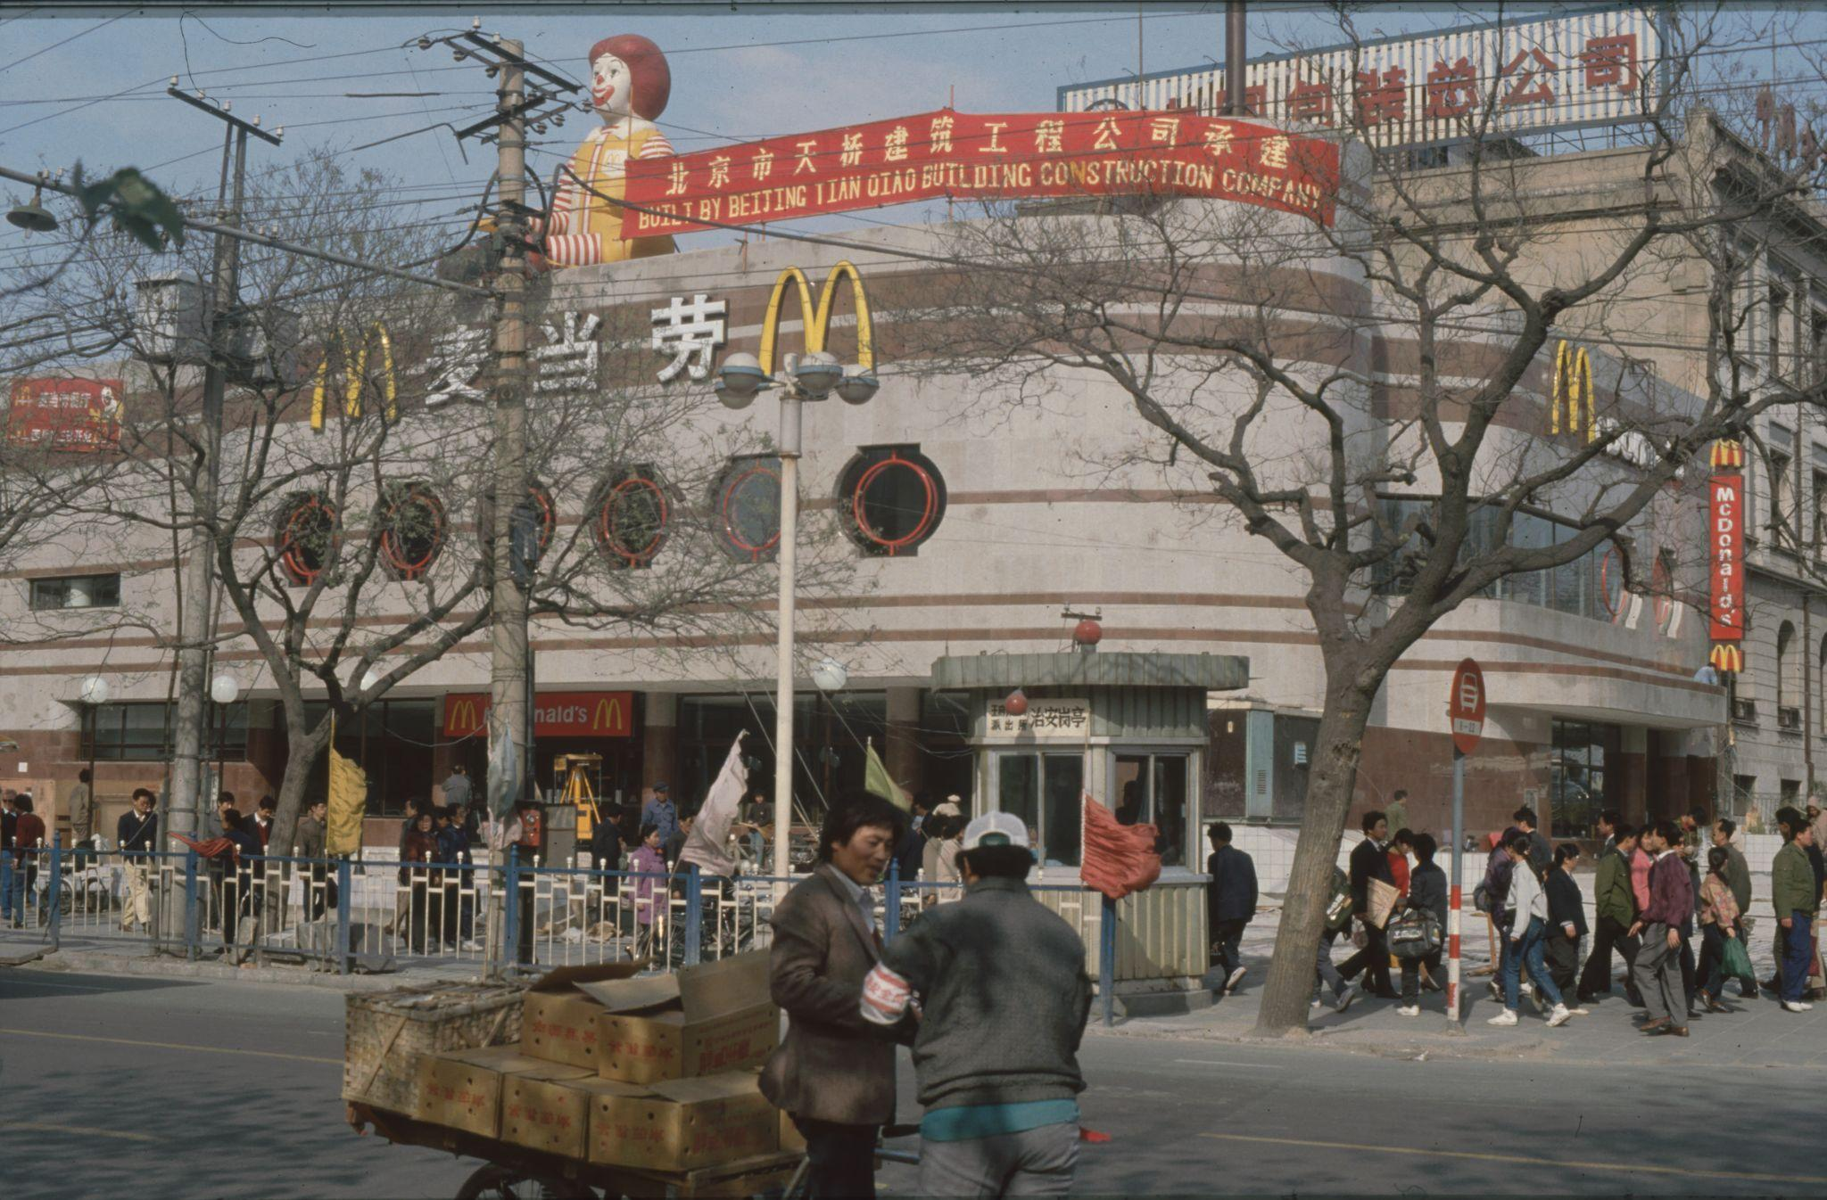

Slide 14
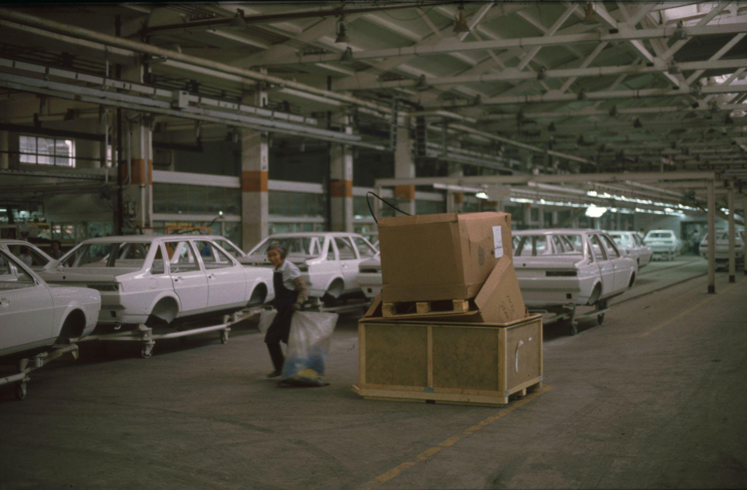

Slide 15
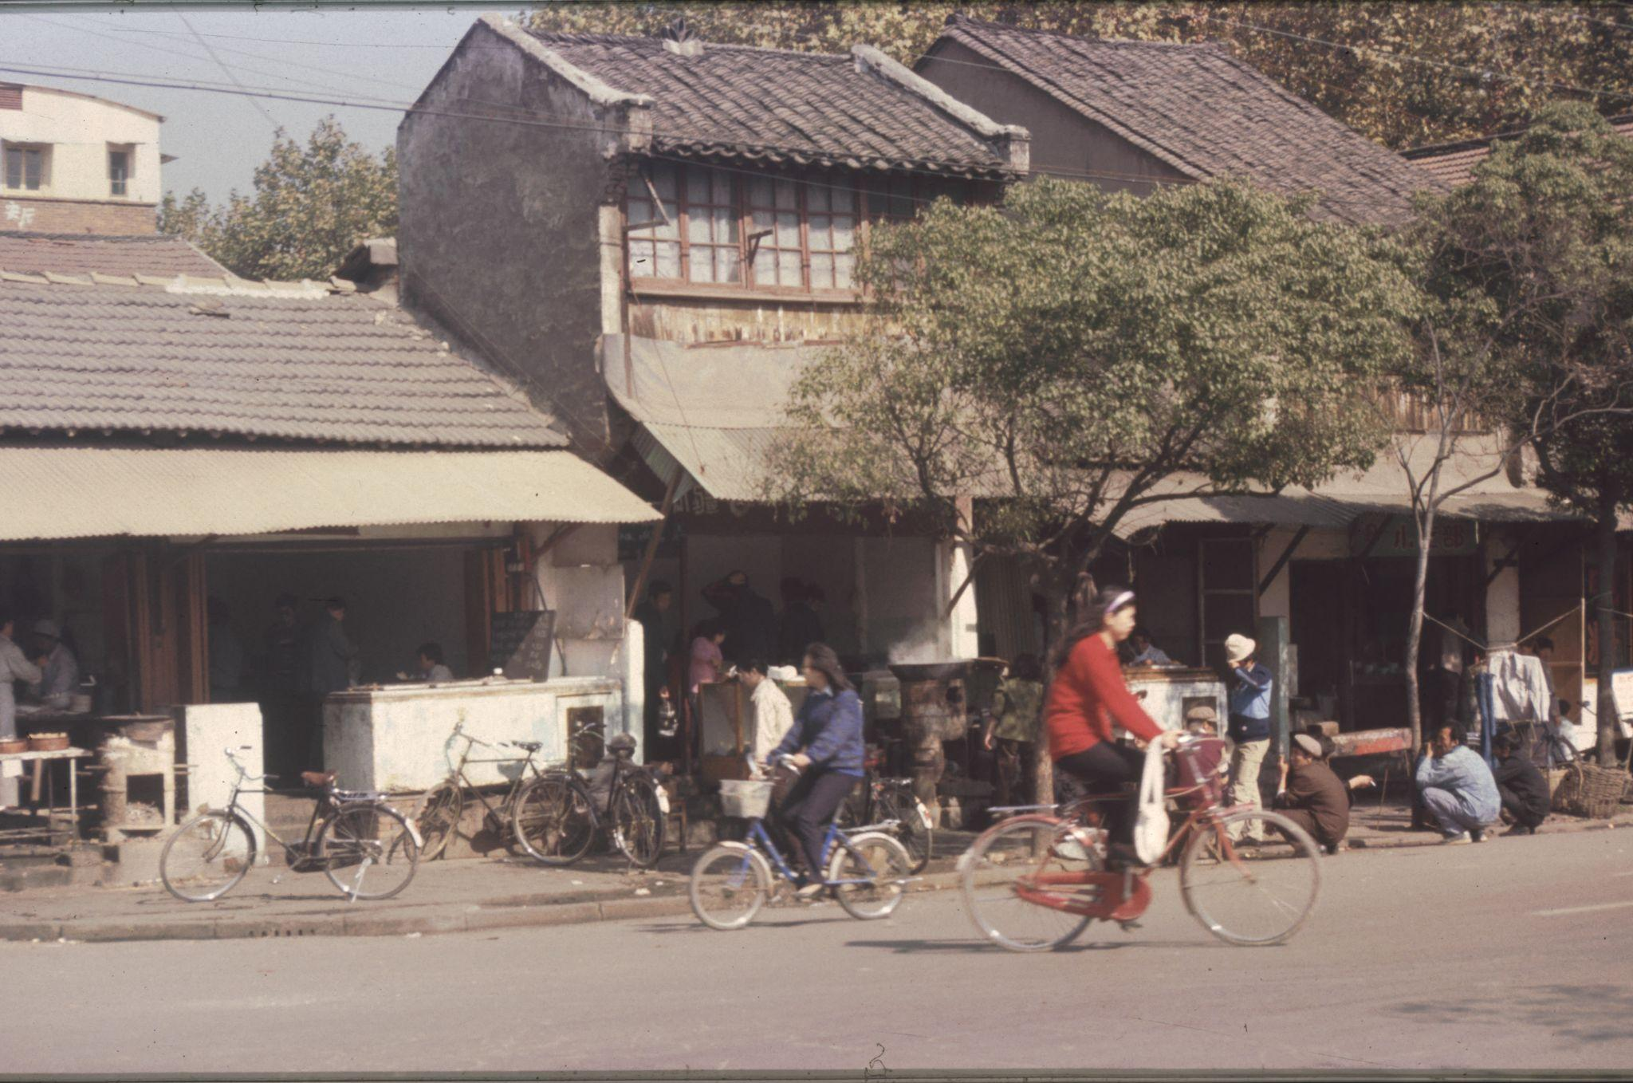

Slide 16
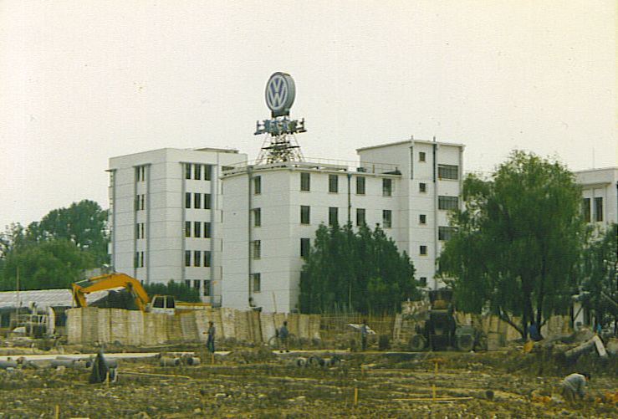

Slide 17
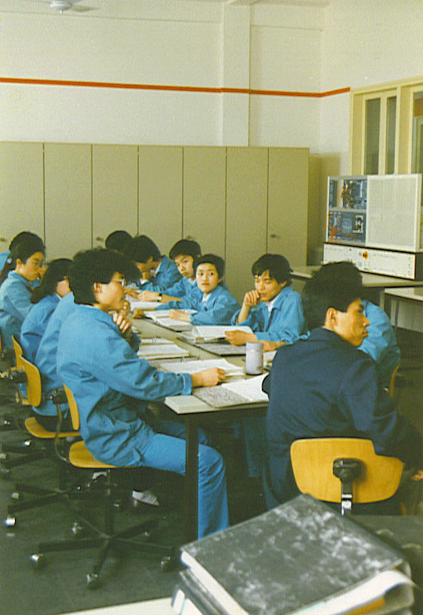

Slide 18
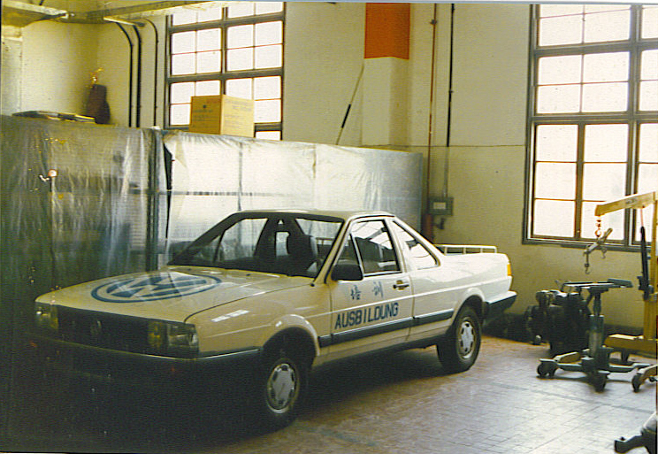

Slide 19
